Slide 1
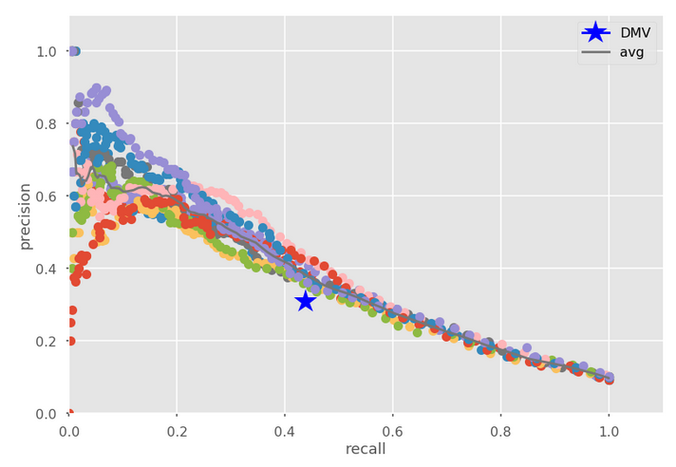
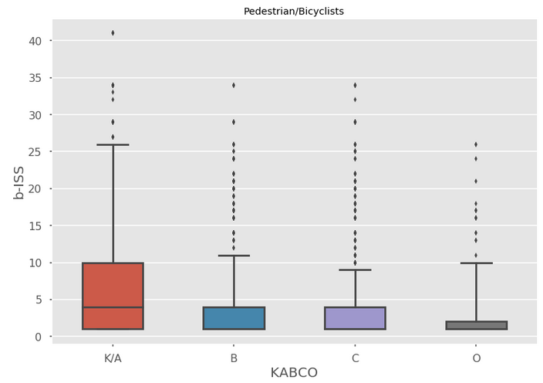
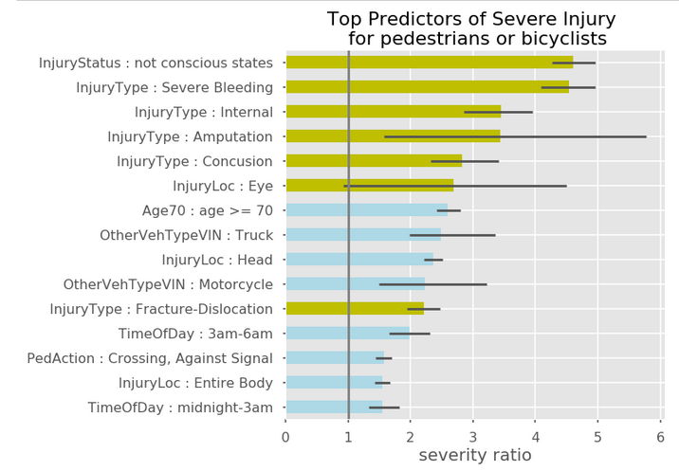
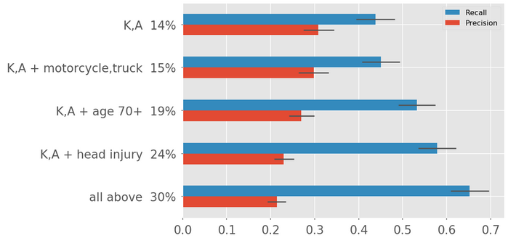



Predicting pedestrian injury outcomes from motor vehicle crashes using data linkage
Deena Patel¹, PhD; Lawrence Fung², MPH; Seth Hostetter³, Rob Viola³, and Catherine Stayton², DrPH, MPH
¹Mayor’s Office of Data Analytics (MODA), City of New York
²New York City Department of Health and Mental Hygiene (NYC DOHMH), Bureau of Environmental Disease and Injury Prevention
³New York City Department of Transportation (NYC DOT), Office of Research, Implementation, and Safety
Introduction
In addition, DOHMH used traffic-related diagnostic codes from the International Classification of Diseases 9th Edition, Clinical Modifications (ICD-9-CM) to assign injury severity scores (b-ISS) based on patient billing records.
Using the linked data and the hospital derived injury severity score (b-ISS), MODA evaluated the current DOT severity formula (KABCO) and presented two methods to improve on the original formula.
Metrics: Measuring improvement
2. Scoring Method
We fit the data to logistic regression models. Using cross validation, we evaluated the models by estimating optimal recall (maximizing recall and keeping precision at the baseline KABCO value).
This was evaluated for different sets of input variables.
Motor vehicle traffic injuries are a leading cause of injury and death in New York City (NYC) with over 200,000 motor vehicle crashes annually. Of these, 40,000 involves an injury, but the vast majority of these are minor. Crash information is typically collected at the scene by responding police officers and includes information on vehicles involved, location, crash type, environmental factors and a field assessment of potential injuries.
NYC DOT uses a crash severity formula, called KABCO, to translate the field assessment of injury into a severity rating. The formula categorizes people involved in crashes into five categories: K (killed), A (severe injury), B (moderate injury), C (minor injury), and O (no injury). Areas with high concentrations of killed or severely injured (K or A) pedestrian or bicyclist crashes are given priority for street redesign safety projects.
The alignment of field-based injury assessments from crash reports and hospitalization data is relatively unknown and unevaluated. Linking crash reports to hospital data gives us a way to evaluate and improve on the KABCO formula.
Precision – crashes predicted “severe,” how many actually are severe? (e.g., correctness of labeled values)
True Positive / (True Positive + False Positive)
Recall – crashes actually “severe,” how many are predicted correctly by the model (e.g., capture rate)
True Positive / (True Positive + False Negative)
Figure 6. Precision recall curve – Scoring Method
Injury Severity Ratio
Maximize precision
MODA calculated the severity ratio to identify which crash circumstances are more indicative of severe crashes.
The Hospital derived injury scores (b-ISS) were used as the measure of severity. Patients with b-ISS > 8 were considered severe cases.
Figure 4. Box whisker plot, KABCO vs. b-ISS
Maximize recall
Baseline
KABCO
P(severe | attribute present)
Severity Ratio =
P(severe)
Figure 2. Calculating severity ratio
Actual (hospital derived b-ISS)
Table 1. Severe Injuries from KABCO formula
Findings
Age is the most important non-injury attribute
20% improvement in the recall metric:
Precision held constant at 31%
Recall increased from 44% to 53% (+/-5%)
Crash report question | Crash report response
Injury Status | Death Unconscious Incoherent
Injury type | Amputation Concussion Internal, severe bleeding Severe/moderate burn Fracture-dislocation
Injury location | Eye
Results
Predicted Label (KABCO)
Conclusions
Figure 3. Top predictors of severe injury
Baseline KABCO
Precision = 31%
Recall = 44%
Accuracy = 85%
DOT’s current severity formula, KABCO, on crashes involving a vehicle and a pedestrian or bicyclist aligns with hospital-derived injury severity findings.
Our main finding is that the age of the pedestrian or bicyclist plays a large role in crash injury outcomes. Older adults, 70+, are over twice as likely to have severe hospitalization outcomes as a random person who is hit.
A simple improvement to KABCO, called KABCO Plus, which added one or more additional categories, showed an increase in recall, but a corresponding decrease in precision.
The Scoring Method is more flexible. It uses logistic regression coefficients to score a crash. A threshold was chosen to allow for an increase in recall without sacrificing precision (or vice versa). Ultimately, improvements using this method are relatively modest.
1. KABCO Plus Method
Adding new categories to KABCO
Age 70+
Head injury
Other vehicle = motorcycle or truck
Methods
Figure 5. Recall and precision results
NYC DOHMH led an effort to create a linked dataset (2011-2013) of crash and hospital records.¹
Figure 1. Venn diagram of data sources for data linkage
All crashes
KABCO severe (attributes with green bars) tracks with the hospital outcomes severity.
Other attributes leading the list of top predictors of severe injury include: age over 70, head injuries, and being hit by a motorcycle or truck .
Police-reported crashes (MV-104)
Taken to hospital (SPARCS)
Linked data
By adding other variables, recall is improved, but precision deceases, relative to KABCO baseline.
For more information, please contact: lfung1@health.nyc.gov.

